Slide 1


Slide 2


EduBench
Pre-Final Year Project Synopsis
Submitted by
ROLL | NAME
SEEMA KANWAR | 2301410020
PAYAL RATHORE | 2301410022
ERIN ANTIL | 2301410011
AYUSHI KUMARI | 2301410035
Faculty Mentor: Ms. Neha Kaushik Group code : 26E3242 NullX
Notes:
New Courses replaced with New Programmes

Slide 3

Project Overview
Learning applications are widely used by children and students, yet their educational quality varies significantly. Many apps are labeled as "educational" without adhering to established learning theories or evidence-based instructional principles. This project proposes a standardized educational quality benchmark to objectively evaluate and compare learning apps based on Bloom’s Taxonomy and proven learning science principles. The benchmark aims to support educators, parents, institutions, and developers in identifying high-quality educational applications.
Notes:
New Courses replaced with New Programmes

Slide 4
Specific Objectives
To understand the need for standardization in evaluating learning apps
To identify key educational quality indicators based on learning theories
To apply Bloom’s Taxonomy to define measurable evaluation criteria
To design a scoring rubric for objective app comparison
To analyze and compare the educational quality of selected learning apps
Notes:
New Courses replaced with New Programmes

Slide 5
Key Features
Theory-driven evaluation framework
Bloom’s Taxonomy–based learning level assessment
Evidence-based learning indicators (feedback, engagement, assessment)
Quantitative scoring rubric for comparison
Simple and reusable benchmark model
Notes:
New Courses replaced with New Programmes

Slide 6
Project Usecases & Scope
Use Cases:
Parents selecting quality learning apps for children
Educators integrating apps into teaching
Institutions reviewing digital learning tools
Developers improving educational effectiveness
Scope:
Focus on children’s and student learning apps
Evaluation limited to educational quality (not UI or marketing)
Benchmark applicable across multiple app categories
Notes:
New Courses replaced with New Programmes

Slide 7
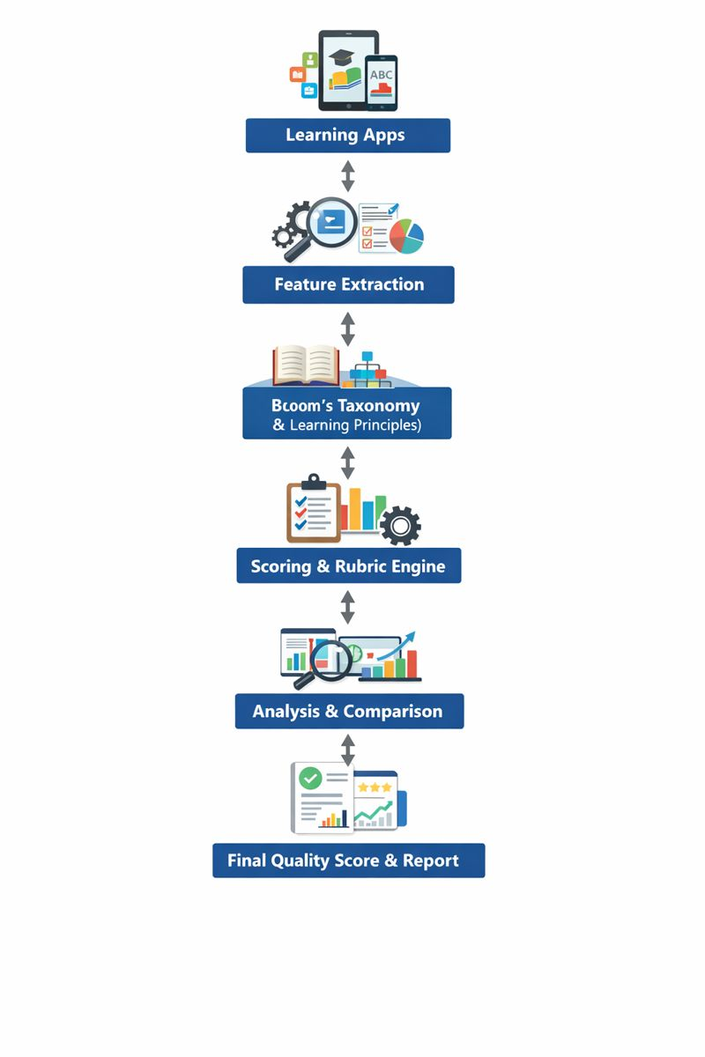
Prototype/Project Flow diagram/Architecture
Notes:
New Courses replaced with New Programmes

Slide 8
Data & Resources
App descriptions, feature lists, and usage observations
Learning apps from Google Play Store / App Store
Bloom’s Taxonomy framework
Evidence-based learning research papers
Tools:
Python (for scoring & analysis) / MIT App Inventor 2 (for prototype)
Notes:
New Courses replaced with New Programmes

Slide 9
Methodology
The project follows a structured approach to evaluate the educational quality of learning apps using a standardized benchmark.
First, existing learning app evaluation methods and learning theories such as Bloom’s Taxonomy were studied to understand key educational quality requirements. Based on this study, important learning indicators like cognitive level coverage, active learning, feedback, and assessment were identified.
Next, a benchmark framework was designed by mapping app features to Bloom’s Taxonomy levels and evidence-based learning principles. A standardized scoring rubric was then created to assign numerical scores to each criterion.
Selected learning apps were evaluated using this rubric. Python was used to calculate total scores and compare apps objectively. Finally, the results were analyzed and presented as quality scores and comparison reports.
Learning Apps → Feature Extraction → Benchmark Framework → Scoring & Rubric → Analysis → Final Quality Report

Slide 10
Expected Results & Impact
The project is expected to produce a standardized and reliable benchmark for evaluating the educational quality of learning apps. The benchmark will provide objective quality scores based on Bloom’s Taxonomy and evidence-based learning principles.
Using this framework, different learning apps can be compared clearly, helping identify high-quality apps and highlighting areas where apps lack meaningful learning support. The results will make it easier for parents and educators to select effective learning applications.
The project will also guide app developers in improving educational design and support institutions in making informed decisions when adopting digital learning tools.
Notes:
New Courses replaced with New Programmes

Slide 11
Project Timeline
Phase No. | Project Phase | Duration
Phase 1 | Problem Study & Literature Review | Weeks 1 – 2
Phase 2 | Benchmark Design & Criteria Definition | Weeks 3 – 4
Phase 3 | Scoring Rubric Development | Weeks 5 – 6
Phase 4 | Learning App Evaluation & Analysis | Weeks 7 – 8
Phase 5 | Results, Documentation & Presentation | Weeks 9 – 10
Notes:
New Courses replaced with New Programmes

Slide 12
THANK YOU

